Slide 1
Hand Tracking Glove
Presented by Daniel Hamilton (EE)
Consulting Engineer - Shantanu Gulgule (EE)

Slide 2
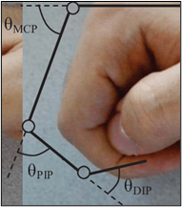
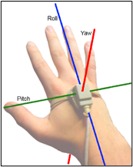
Introduction
The glove aims to capture bends in finger joints and orientation of the hand.
Wirelessly transfers raw sensor data to a DSP effects rack to control parameters of various effects and audio controls.
Figure 1: Finger joints (left) and 3 axes of hand orientation (right).

Slide 3
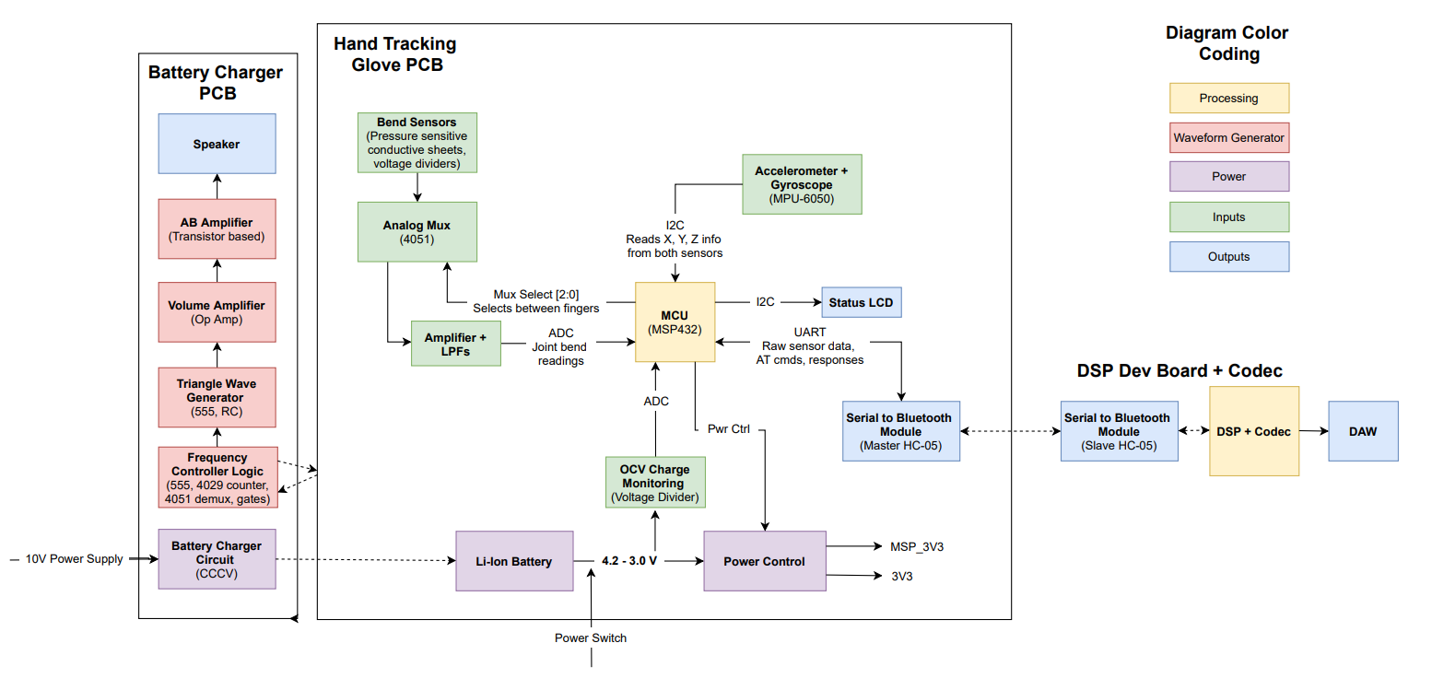
Hardware Diagram
Figure 3: High-level hardware diagram.

Slide 4
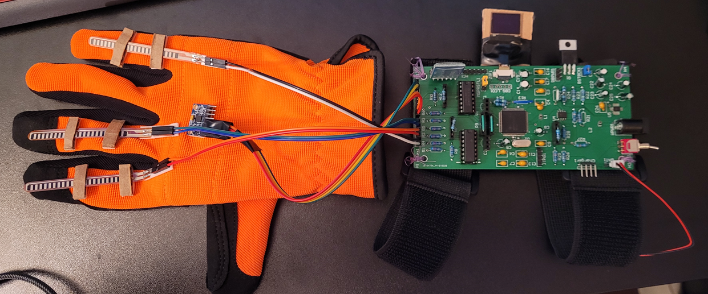
PDR Features & Status (GLOVE)
Notes:
Glove’s primary goals are to collect/transfer raw data to the desktop with minimum latency.
Desktop application performs most data processing.
Processed data controls the video game demo.

Slide 5
PDR Features & Status (Flex Sensors)
Feature
[Original Requirement] Capture bends in 2 joints for all 5 fingers on the right hand.
[Modified & Approved Requirement] Capture bends in 3 fingers as a proof of concept. This should be easily extendable to a greater number of joints.
Finger sensor bend resolution must be high enough to detect noticeable differences in MCP or PIP joint movements.
Status
N/A
Complete. 5 more mux inputs are still available to attach more flex sensors. Originally used homemade flex sensors, but these were too sensitive to attach to the glove. Swapped out for $10 Adafruit flex sensors.
Complete. Can capture ~130 values between min and max bend per flex sensor.
Notes:
Glove’s primary goals are to collect/transfer raw data to the desktop with minimum latency.
Desktop application performs most data processing.
Processed data controls the video game demo.

Slide 6
PDR Features & Status (Orientation)
Feature
[Original Requirement] Provide sensor data that can be converted into hand orientation values on all 3 axes.
[Modified & Approved Requirement] Provide pitch and roll orientation data. The third axis cannot be calculated accurately due to inductor magnetic field interference and issue with magnetometer part (MPU6050 mislabeled as MPU9250).
Status
N/A
Complete. Orientation calculated based on accelerometer data by relating the gravity vector to the sensor’s frame. The gyroscope is used to correct the gravity vector since the accelerometer is sensitive to vibrations.
Notes:
Glove’s primary goals are to collect/transfer raw data to the desktop with minimum latency.
Desktop application performs most data processing.
Processed data controls the video game demo.

Slide 7
PDR Features & Status (Wireless)
Feature
The glove must operate wirelessly.
I will power the glove with a rechargeable battery.
I will transmit data to the DSP effects rack using Bluetooth.
Status
Complete.
Complete. Used a buck/boost converter to create 3.3V power rail from a single cell battery ranging from 3V – 4.2V.
Complete. Master sends a sensor data update, and slave returns an acknowledge message. There is also a timeout period in case the HC-05’s are still connected, but the C2000 is restarted.
Notes:
Glove’s primary goals are to collect/transfer raw data to the desktop with minimum latency.
Desktop application performs most data processing.
Processed data controls the video game demo.

Slide 8
PDR Features & Status (Status LCD)
Feature
Provide a text-based user interface on the glove using an LCD.
This display with show the battery’s charge percentage.
The LCD will also show Bluetooth connection status.
Status
Complete.
Complete. State of charge is estimated using the battery’s Open Circuit Voltage captured at power on and an estimated static current draw during runtime.
Complete. There is a “searching” animation while the master HC-05 looks for the slave device. Once paired, the LCD shows “Paired” on the LCD.
Notes:
Glove’s primary goals are to collect/transfer raw data to the desktop with minimum latency.
Desktop application performs most data processing.
Processed data controls the video game demo.

Slide 9
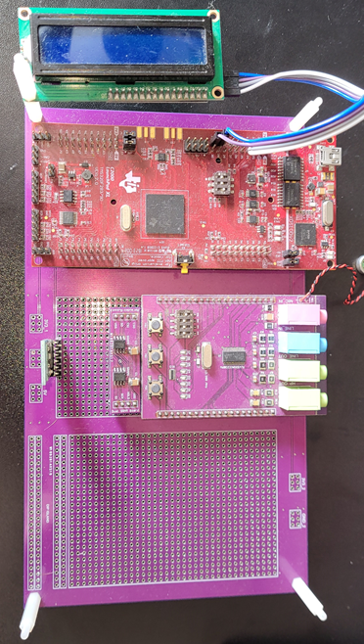
PDR Features & Status (DSP Effects)
Feature
Use data from the glove control a high-pass / low-pass filter cutoff frequencies, pitch shifting, and FX enabled/disabled.
Must receive data via Bluetooth.
Optionally implement time-domain echo if time permits.
Status
Complete. HPF, LPF, and pitch shifting are implemented inside an FFT/FX Processing/IFFT pipeline. All processing is completed in less than (2*1024)/48k seconds to avoid audio stuttering.
Complete. Used a slave HC-05 module to connect with the glove’s master HC-05.
Alternative Found. Was unable to implement echo in time, but I did substitute this with audio volume control.
Notes:
Glove’s primary goals are to collect/transfer raw data to the desktop with minimum latency.
Desktop application performs most data processing.
Processed data controls the video game demo.

Slide 10
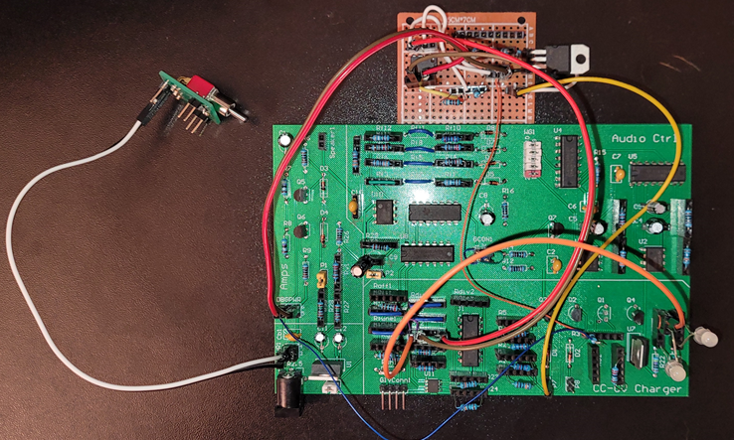
Preliminary Design Report Features (CHARGER)
Notes:
Glove’s primary goals are to collect/transfer raw data to the desktop with minimum latency.
Desktop application performs most data processing.
Processed data controls the video game demo.

Slide 11
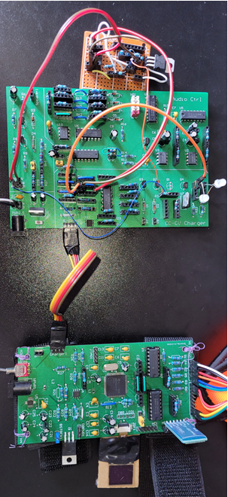
PDR Features & Status (Device Detection)
Feature
The charger PCB will automatically detect when the glove PCB is connected or disconnected even if the Li-ion battery on the glove PCB is fully depleted.
Status
Complete. A pullup resistor on the charger is pulled low when connected to the glove through the charge cable. Combining an XOR gate with an RC circuit creates a short pulse when a connection/disconnection happens.
Notes:
Glove’s primary goals are to collect/transfer raw data to the desktop with minimum latency.
Desktop application performs most data processing.
Processed data controls the video game demo.

Slide 12
PDR Features & Status (Tune Generator)
Feature
When connected or disconnected, play a 4-note tune. The tunes should be played forwards or backwards when connected / disconnected.
This must work independently of the glove – i.e. must work without using the microcontroller and glove battery charge should not affect the tune generator.
Status
Complete. Controlled direction of the tune using a counter’s DIR pin. Used a DFF with the connection detector circuit to decide whether to play the tune forwards or backwards.
Complete. Used timers, counters, and logic gates to control the frequency of the note generated.
Notes:
Glove’s primary goals are to collect/transfer raw data to the desktop with minimum latency.
Desktop application performs most data processing.
Processed data controls the video game demo.

Slide 13
PDR Features & Status (Audio Amps)
Feature
Volume should be set to a comfortable volume using a voltage amplifier.
Audio should be output to a low-impedance speaker. This requires power amplification using a class AB amplifier.
Status
Complete.
Complete.
Notes:
Glove’s primary goals are to collect/transfer raw data to the desktop with minimum latency.
Desktop application performs most data processing.
Processed data controls the video game demo.

Slide 14
PDR Features & Status (CCCV Charger)
Feature
This circuit will implement Constant Current (CC) and Constant Voltage (CV) circuits to charge a battery to max capacity.
The circuit will automatically switch between CC and CV modes depending on if the battery has reached ~4.1V.
The circuit will automatically switch off when the battery is in CV mode and draws less than ~5 mA of current.
Status
Incomplete. The CV circuit works correctly, but the CC circuit does not get enough power from the Schmitt MOSFET to provide 55 mA for varying load resistances.
Complete. Switches between CC and CV circuits automatically using a 3.7V – 4.2V Schmitt Trigger and a comparator.
Incomplete. The in-amp and comparator still need to be tuned to detect 5 mA of current flow through the shunt resistor.
Notes:
Glove’s primary goals are to collect/transfer raw data to the desktop with minimum latency.
Desktop application performs most data processing.
Processed data controls the video game demo.

Slide 15
PCB Changes Required
Feature
Glove PCB – Removed 10 Hz LPF circuit from flex sensor readings. The time to discharge the capacitors took too long between readings, so each flex sensor reading was affected by the previous flex sensor reading. Since I removed the bottom 6 bits of the 14-bit ADC reading to compress it into 8-bits, I filtered out the noise in software anyways.
Charger PCB – GCON header in top level should connect pins 1-4 and 3-2 instead of 1-2 and 3-4.
Charger PCB – CV circuit had a 100 Ohm resistor on the output of the CV net. Since the current draw is variable, there is a variable amount of voltage drop across the resistor which ruined the 4.2V CV source.
Charger PCB – CV circuit using op-amp w/ FET replaced with LM317. Unsure why the voltage is not constant with variable loads. Last minute alternative was to swap out the circuit for a regulator.
Charger PCB – CC circuit is not able to provide constant 55 mA current because there is not enough voltage at the input. I would have to do more testing to understand why the MOSFET outputs ~6V instead of closer to 10V when enabled.
Notes:
Glove’s primary goals are to collect/transfer raw data to the desktop with minimum latency.
Desktop application performs most data processing.
Processed data controls the video game demo.

Slide 16
Questions

